Slide 1
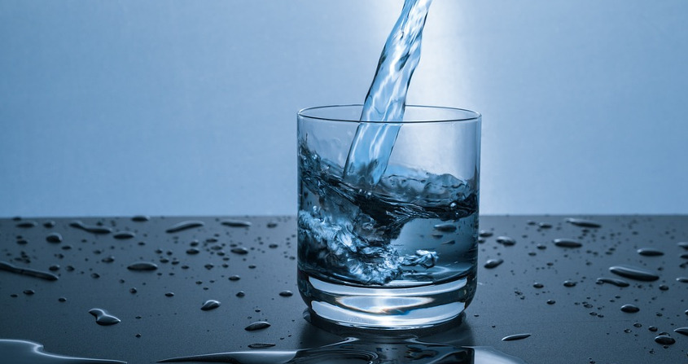
1. The characteristics of drinking water
What is drinking water:
The water that can be consumed without endangering human health.
Water that is clean and pure
physically, chemically, biologically and microbiologically
It should be:
colorless,
odorless,
cool(temperature should be constant at 10-15 degrees Celsius)
with a pleasant taste.
It should not:
be too hard (causes difficulties in its daily and industrial use.
contain large amounts of organic matter, heavy metals or pathogenic parasites or germs.

Slide 2
2. Standards of drinking water
In Greece - a country member of the E. U.- drinking water is governed by the drinking water quality directive of the WHO (3rd edition) 2002 and Directive 98/83 EC directive on the quality of drinking water (3/11/98) by the European Union. The directive is valid for Greece from 1/1/2004.
In general:
water should be clean, colorless, clear, odorless and without unpleasant taste
The water temperature should not exceed 12 oC at the time of distribution
The water must be of medium hardness (80-150 ppm CaCO3 in taste)
The pH should be 7-7.5
It should not contain poisonous or toxic substances and metal compounds
The content of ammonia, nitrites, nitrates and chlorides should be minimal
and not exceed the permitted limits
The water supply should be permanent, without interruption and in sufficient quantity
Be free of pathogenic microorganisms

Slide 3
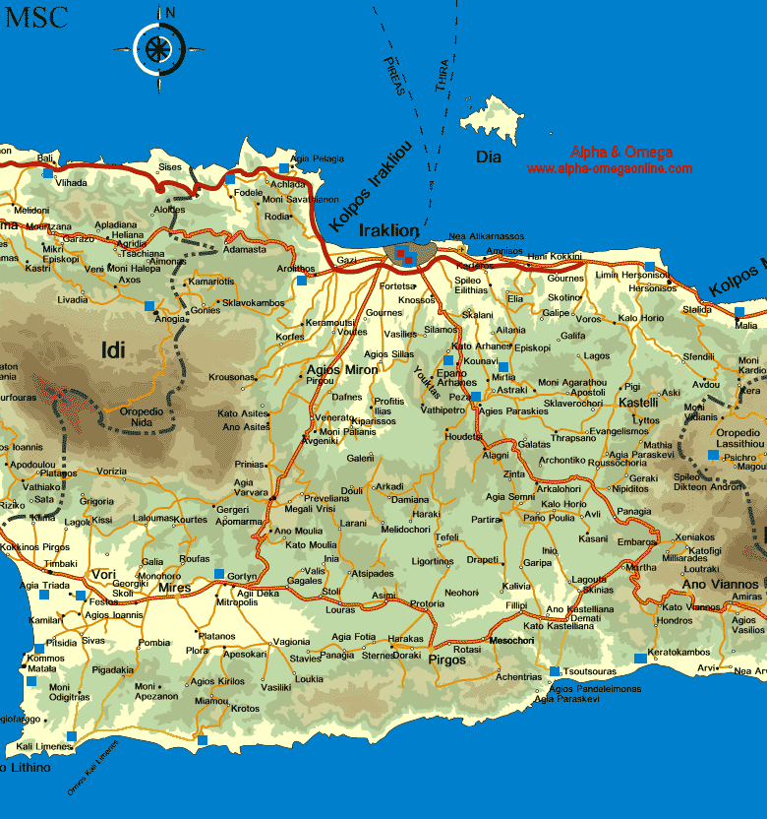
In Heraklion:
Within the city of Heraklion, especially in the center, people don’t drink the tap water because of its taste. In different parts of Heraklion territory though, tap water is drinkable.
Frequent analysis of the water that ends up to the houses are being held and they all prove that the E.U standards are easily met.
See the tables that follow:

Slide 4
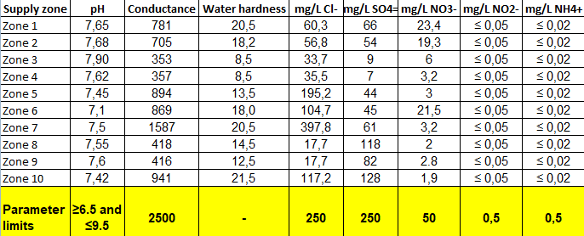

Slide 5
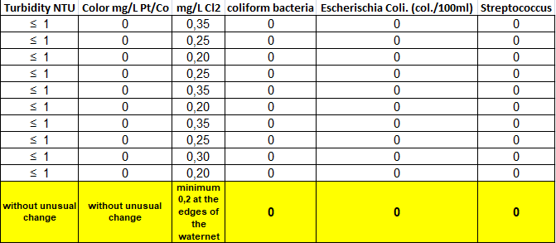

Slide 6
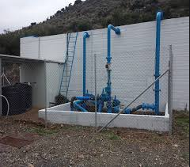
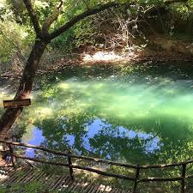
3. How is drinking water supplied to households in your region? Are there any differences between bigger towns, smaller villages, or isolated settlements?
The city of Heraklion is being supplied with water through a net of pipelines that lead the underground water of natural springs and noumerous drillings around the city to the households.
The underground water comes from the drain basin of the mountains located south and west of the city.
Neraidospilios (Cave of fairies): One of the Natural springs that water Heraklion.
Drilling

Slide 7
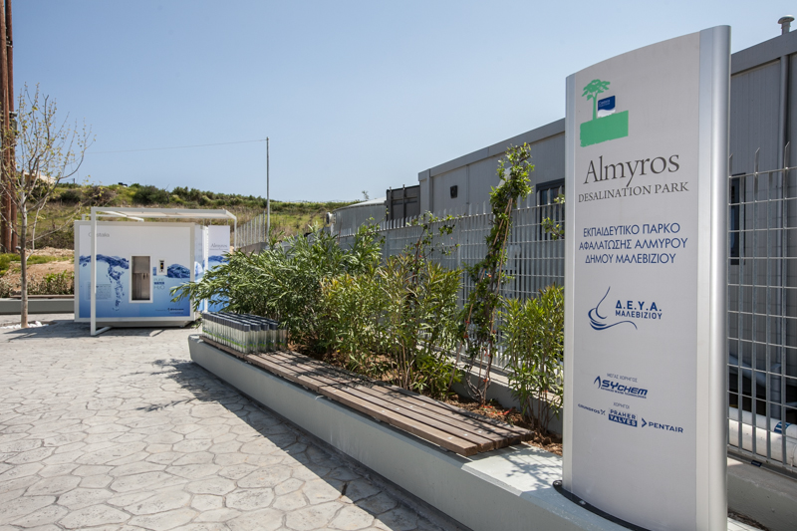
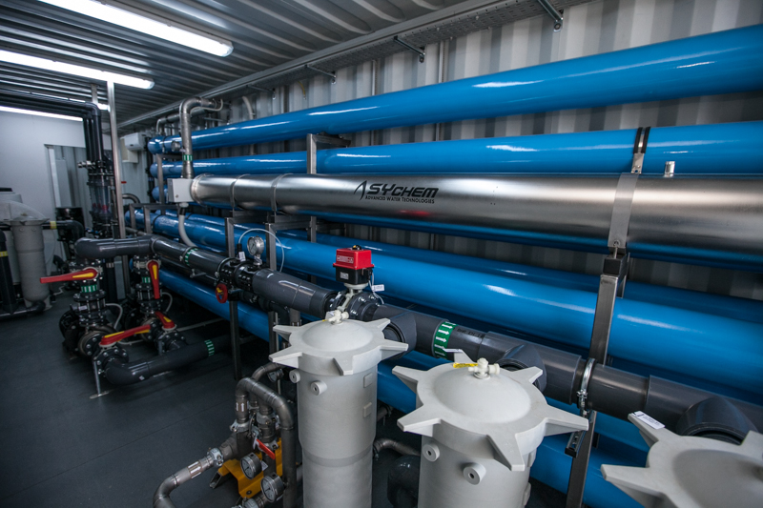
Also, 2000 m3/day are being supplied to Malevizi, a region of Heraklion, after it is being desalinated at Almyros Desalination Park.

Slide 8
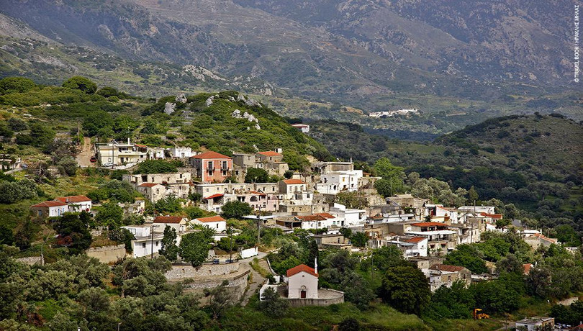
Villages in the region of Heraklion are supplied as well with water through pipelines from nearby drillings.
Some isolated settlements use the water from drilling or natural fountains.

Slide 9
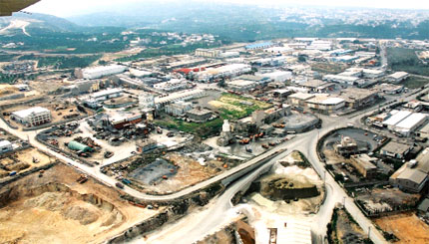
4. How is water supplied to the industry? Do they receive a different type of water than house-holds?
The water supplied to industries in our area is exactly the same water that reaches the households.

Slide 10
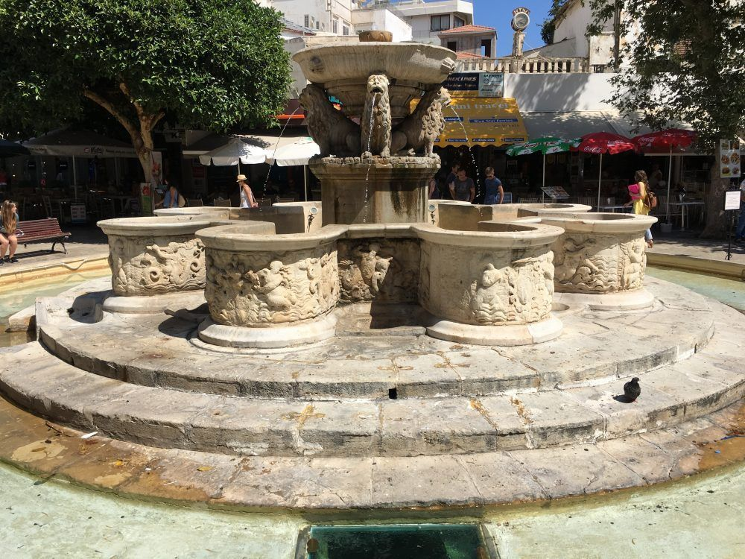
5. How has the procurement of water in your region changed over time?
Crete has always had lack of water!
Drinking water has always been a problem that needed to be solved!
During Venetian Occupation: The fountain of Morozini (Lions) was built in the center of the city, bringing fresh water from the mountain of Yuchtas through a canal.

Slide 11
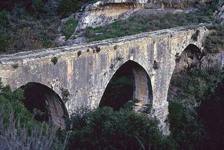
During Ottoman Occupation:
The ancient aqueduct of Knossos was found and reconstructed.
An aqueduct of about 15 kilometers long, which carried the water of various sources from the northern slopes of the Yuchtas mountain to the fountain of “Lions” and other numerous public fountains where people were going to take water with ceramic pots, the pitchers.
In 1920s another aqueduct was constructed near the village of Astrakoi (south of Heraklion) connecting the city with more natural springs.
From 1960s until today: the water net of the city was expanded or/and replaced, drillings at the slopes of the mountains near the city were constructed.
The water was reaching to every single house in the city.

Slide 12
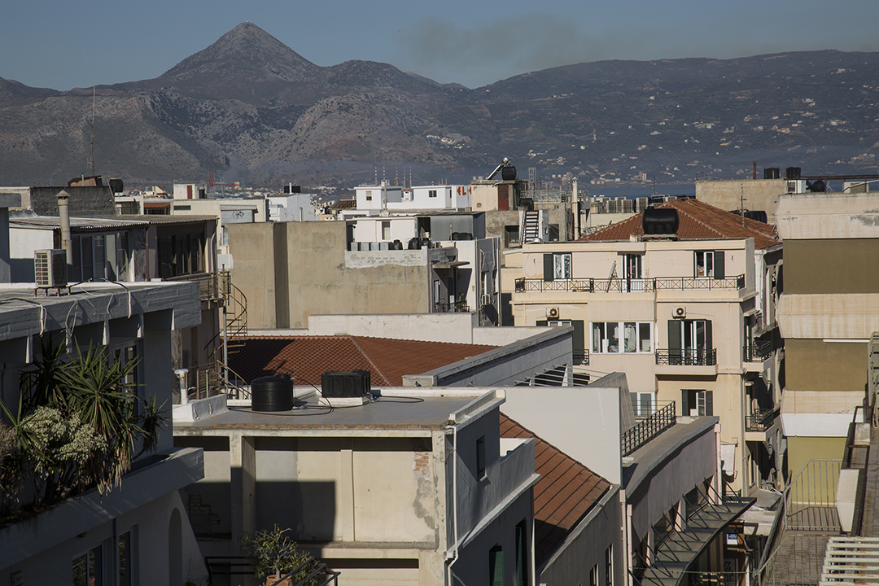
A big part of today’s pipelines are too old and thus destroyed so there is a huge percentage of lost water because of numerous leaks.
As a result, constant flow of water at households of the city is not obtained. At many neighborhoods of the old city the water is available from the public net every other day.
Water is stored in black plastic tanks placed at every terrace, on every building.

Slide 13
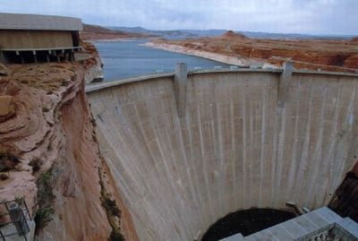
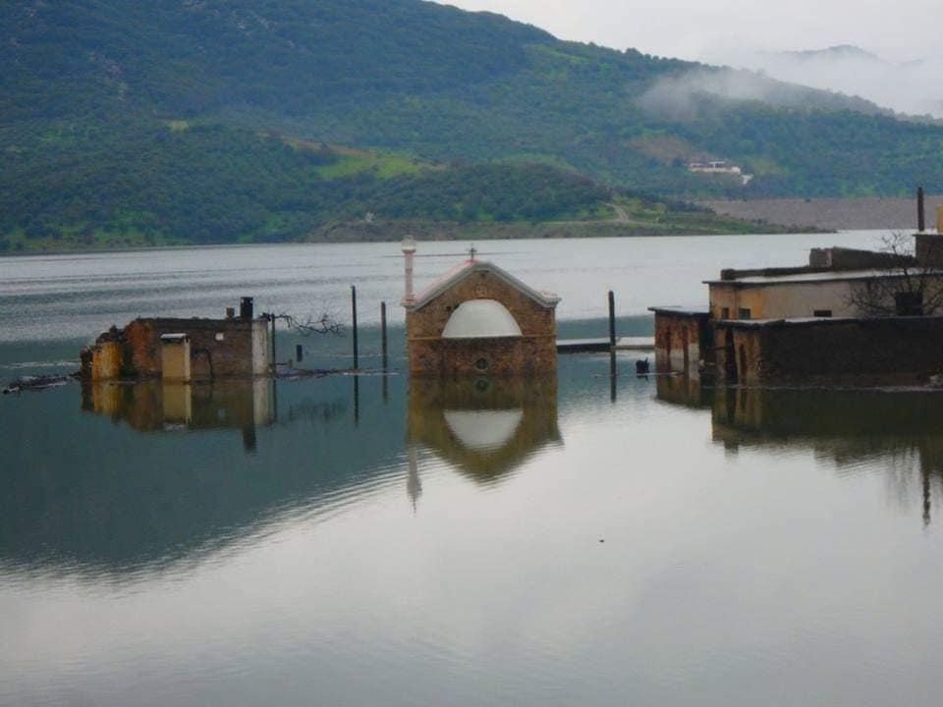
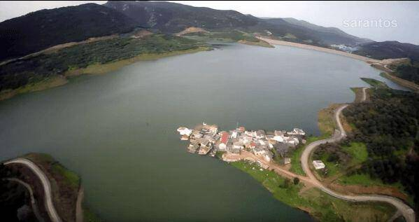
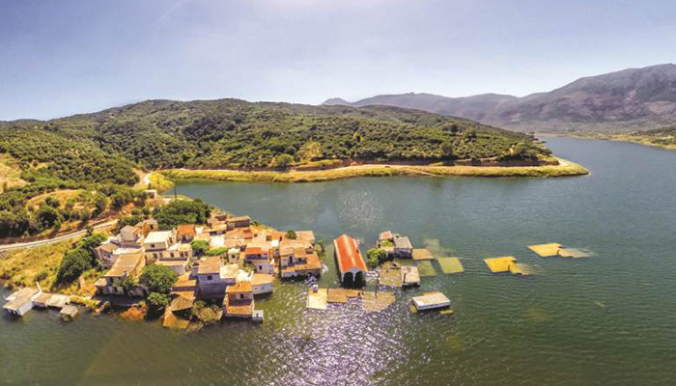
A big damn at Aposelemis river, east of Heraklion city, was constructed hoping to solve Helaklio’s lack of drinking water. 2019 was the first year that it was filled up with water.
Sfendyli, a small village is lost forever under the water.

Slide 14
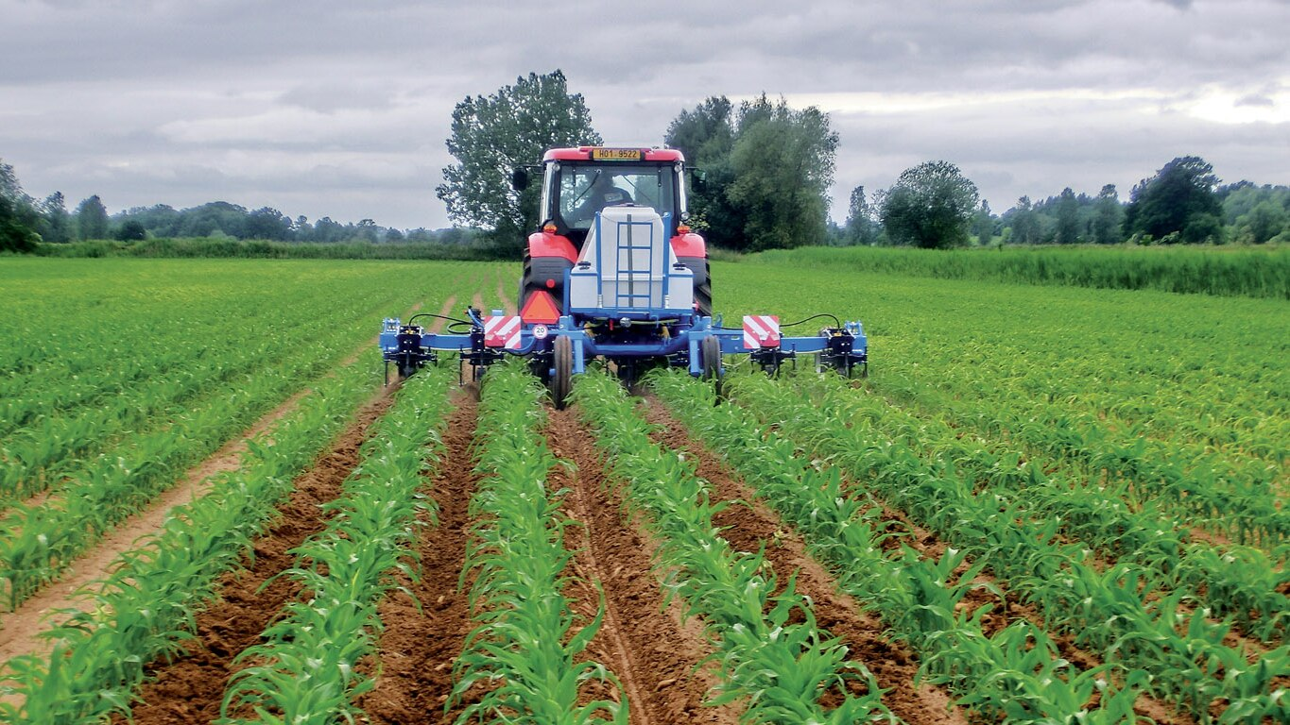
6. What kinds of contamination do your regional water suppliers fear most? How is your drinking water protected against such contamination?
Inorganic chemicals in groundwater, for example NO3–, N2, Cl, SO42–, H+, P, C, K, Mg, Ca, Sr, Ba, Ra, and As, as well as a some pesticides and other organic compounds from agriculture.

Slide 15
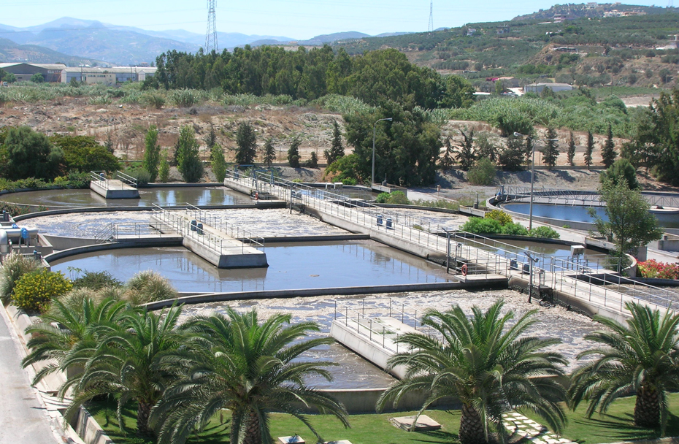
7. How is waste water from households collected, cleaned and made available again?
Waste – water of most of the neighborhoods of the city of Heraklion end up, by gravity, through pipes, to the main biological treatment of our city.
There are also 14 pumps to carry the waste – water of households located in neighborhoods near the coastline which are lower than the location of the Biological Treatment Plant.
After the water is cleaned, it is carried through a pipe into the sea, 4km away from the coast at 12m depth.
A small portion of the clean water is used for agriculture at the area around and is found to have good impact to the plantations (20% more production)

Slide 16
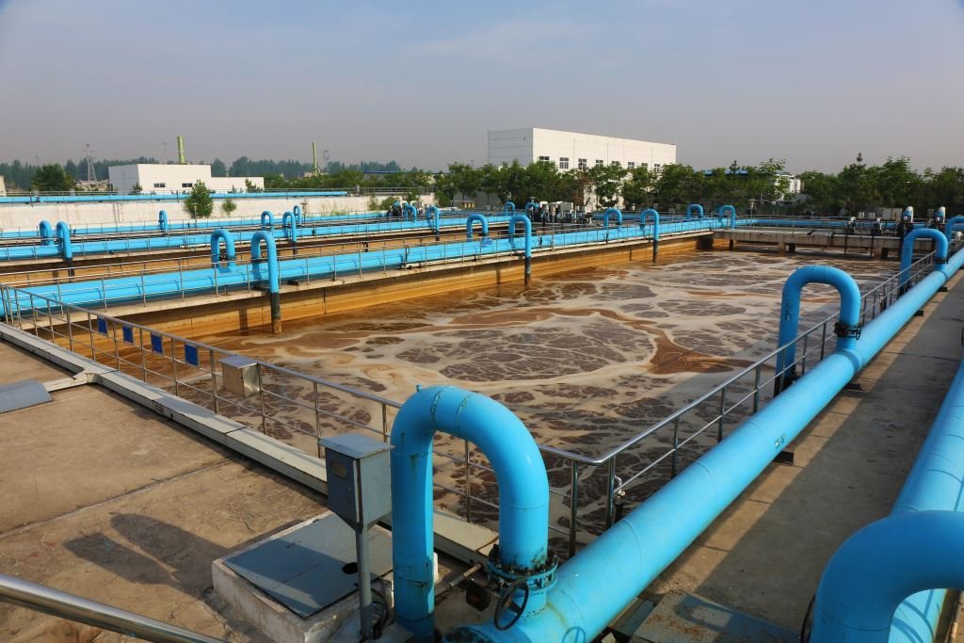
8. How is waste water from industrial complexes collected, cleaned and made available again?
Industries are obligated by law to operate biological treatment of their waste – water.
In the Industrial area of Heraklion, there is a biological treatment where the total waste –water of all the industries end up.
After the procedure of cleaning, the water is poured into the sea.

Slide 17
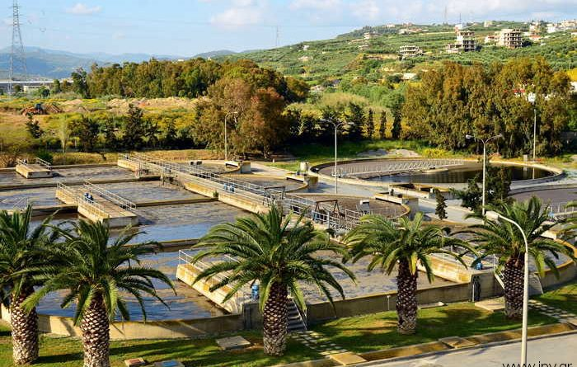
9. How has the treatment of waste water in your region changed over time?
In Heraklion, the main Waste – water Biological Treatment Plant started operating back in 1996.
Until that time waste-water was poured into the sea.
There are smaller biological treatment facilities in many districts, hotels and villages near Heraklion, built during the last 20 years.

