Slide 1
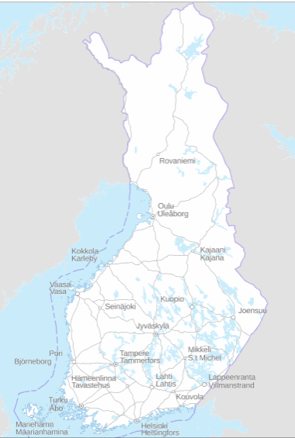
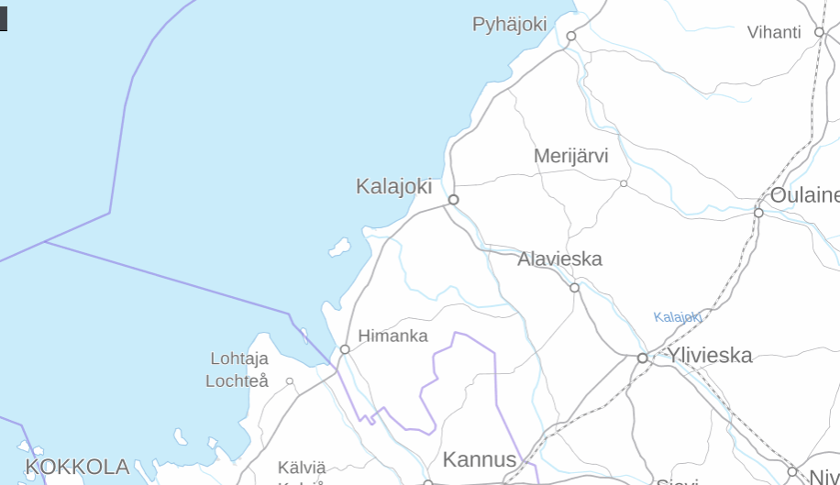
Temperature & rainfall during the last 50 years in Kalajoki

Slide 2
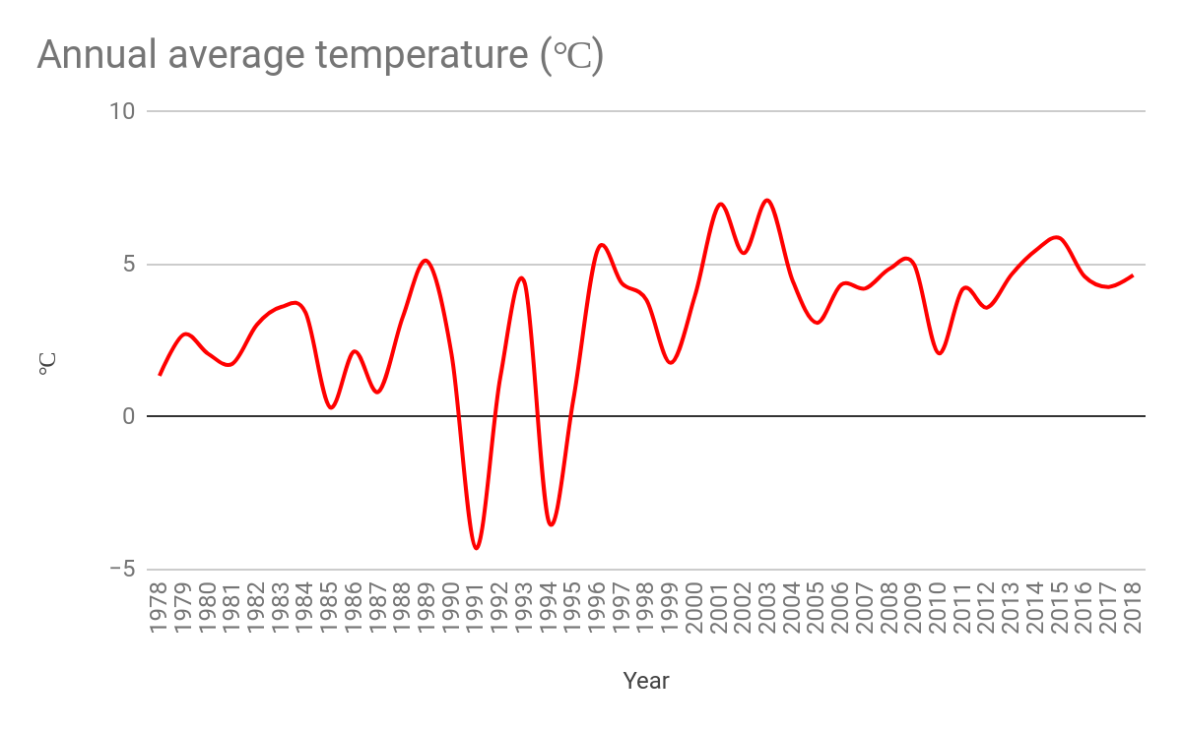
Unfortunately some data is missing. For example years 1990 & 1994.

Slide 3
