Slide 1
Regarding Task 2 of the Module of Environmental and climate change (Spain): Our students watched two videos with young climate activists Greta Thunberg speaking in the UN Rio summit in 1992 and Severn Suzuki in the UN Poland summit in 2018.
https://www.youtube.com/watch?v=kUDv-22Cfqg
https://www.youtube.com/watch?v=flTgbbA7MJs&t=2s

Slide 2
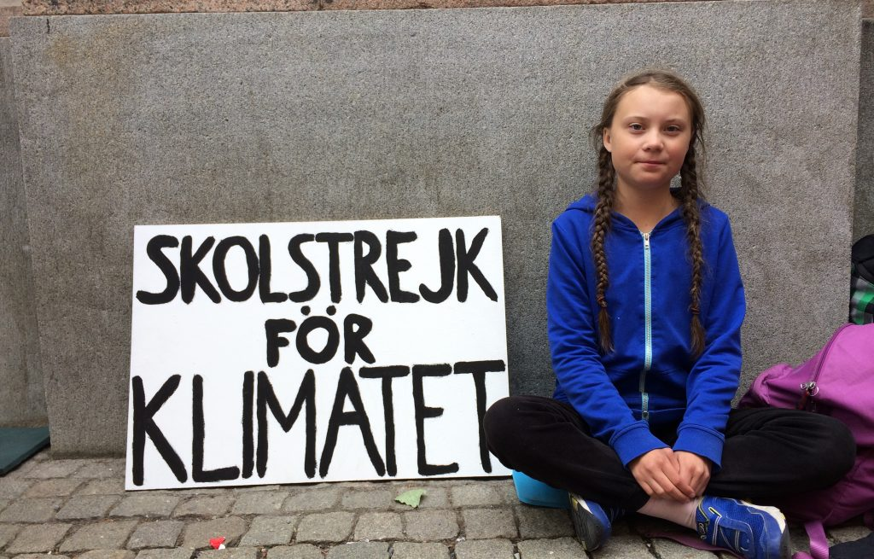
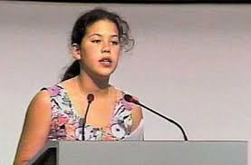

Slide 3
Their learning English level was high enough to understand all the details in their dynamic but also emotional speeches and this gave them a motive to participate in activities about climate change throughout the year.
Moreover, their awareness was induced from the fact that Greta Thunberg’s name was in the headlines of world wide news during the whole year.

Slide 4
They took ideas and wrote THEIR letters
Dear Prime Minister,
My name is Natalia and I’m a student at the 13th Gymnasium of Heraklion, Crete, Greece. I’m writing this letter to inform you about some environmental issues people all over the world have to face and ask for your help so we can make a change and encourage people to do the same.
One of the most important problems is global-warming. We all hear about it in the news all the time but we don’t give the attention that we should because some people think that it’s not a serious issue. It might not seem threatening now but in the future, it will become uncontrollable and it might cause the end of the human race. One of the results it can lead to is to global-level sea rise and very high temperatures. Fortunately, there are many easy ways we can help to provoke these terrible events from occurring. We can try to consume less and focus on using energy more wisely or we can at least inform people about this.
Another issue as important as the last one is pollution. There are different kinds of pollution, air pollution, water pollution and many more that are equally dangerous. All can lead to several health problems that many people suffer from and they can sometimes cause death. We create too much rubbish that ends up in the ocean and as a consequence they pollute the water which not only we use but is the place where many animals live.
Plus, cars are now being used more than ever. The problem is that they produce hazardous emissions that pollute the air we breathe. As I mentioned before, we can help by consuming less, using public transports or just by spreading the word.
I truly believe that you can help make a difference before it’s too late. There are so many measures we can take, more than I’ve written in this letter and I hope that you will help in the near future by giving a speech to inspire people or by personally using the tips that I gave you. Lastly, we shouldn’t do this just to save people’s lives but also to ensure that our planet will have a viable future.
Natalia Vourexaki

Slide 5
Dear President,
My name is Maria, and I am a citizen of this world. I am afraid that out planet will not have a good ending.
Everyday thousands of trees are cut down. Trees give us oxygen and keep the water into the ground, which keeps the floodings away. What we would do without them?
Another important problem is the pollution. Pollution can be dangerous for people, animals and the environment. Nowadays people produce TOO much trash that usually ends up in the ocean.
Global warming is another important issue that I am concerned about. Global warming is caused in large part because of the greenhouse effect.
Earth is a beautiful place and we must keep it alive as long as we can. This is the time that policy must change to protect our home. So, I hope you will be the one who will make the right choice and help us save the world.
Yours sincerely,
Maria

Slide 6
Dear Sir or Madam
I am writing you to express some concerns of mine and of other people my age about climate change and the actions we should undertake as a country to prevent it.
A few days ago, I read in a scientific magazine that the pace of ice loss in Greenland has increased fourfold since 2003 and that scientists say “the only thing we can do is adapt and mitigate further global warming, there is no way of it having no effect anymore.”
As a country we must take steps to prevent that from happening and escalating to a bigger problem than it already is.
Children should be aware of and sensitive to this matter. In my opinion a good way to make that happen is to include environmental awareness as a school subject. Also, we should try to reduce the pollution of the air by promoting the use of environmentally-friendly fuels.
The fact that so much money is spent for the army, money that could fund our attempts to solve this serious problem is making e angry.
I hope this letter will help or, at least, persuade you to do some thinking and consider doing something.
Yours faithfully
Vouidaskis Mihalis

Slide 7
Dear Sir or Madam, My name is Lydia Melissourgaki and I am 13-year-old student. But even more important than this I am 13-year-old Greek citizen who is writing to express her concerns about the environment. Climate change is an ongoing and exceedingly important global phenomenon, which is affecting our country as well. People say that in Greece we are blessed because summer lasts until the end of October. However is this blessing or a curse? In my opinion it is a curse because this extended summer is a result of climate change and it can only lead to long periods of drought. Also because of climate change the sea levels in the Mediterranean rise. Unless we take action, animals’ species will die out and people will lose their homes and life as we know it will disappear forever. Agriculture which is an important part of our economy will be destroyed as well as tourism, on which we greatly rely in our country. The future is nearer than we think and climate change is already in progress. I think we should all try to make a difference for the sake of all the living creatures on Earth, and we need to start making the difference right now! I hope my worries will motivate you to take measures to protect the environment in Greece and save us from despair. Yours faithfully, Lydia Melissourgaki

